Slide 1
Data Models

Slide 2
Data models, Schemas, and Instances
Data model:-A set of concepts to describe the structure of a database, and certain constraints that the database should obey.
Schema:- The overall description of the database is called the Database Schema. – A schema is defined as an outline or a plan that describes the records and relationships existing at the particular level.
Instance:- Data in the database at a particular moment in time.

Slide 3
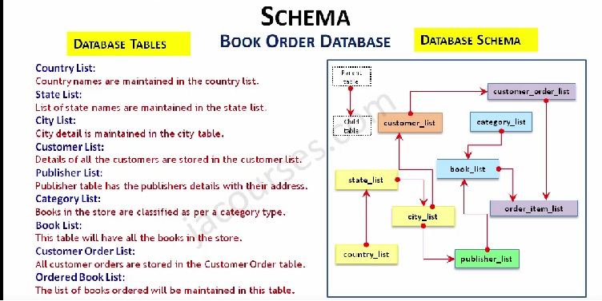

Slide 4
Data abstraction
A major purpose of database system is to provide user with an abstract view of data. That is, system hides certain details of how the data are stored and maintained.

Slide 5
Levels of Abstraction(View of data)
Physical level: describes how a record (e.g., customer) is stored.
Logical level: describes what data stored in database, and the relationships among the data. DBA, who decides what information to keep in the database, use the logical level of abstraction.
View level: describe only part of database .Application programs hide details of data types.Complexity remain due to variety of information stored. Views can also hide information (such as an employee’s salary) for security purposes.

Slide 6
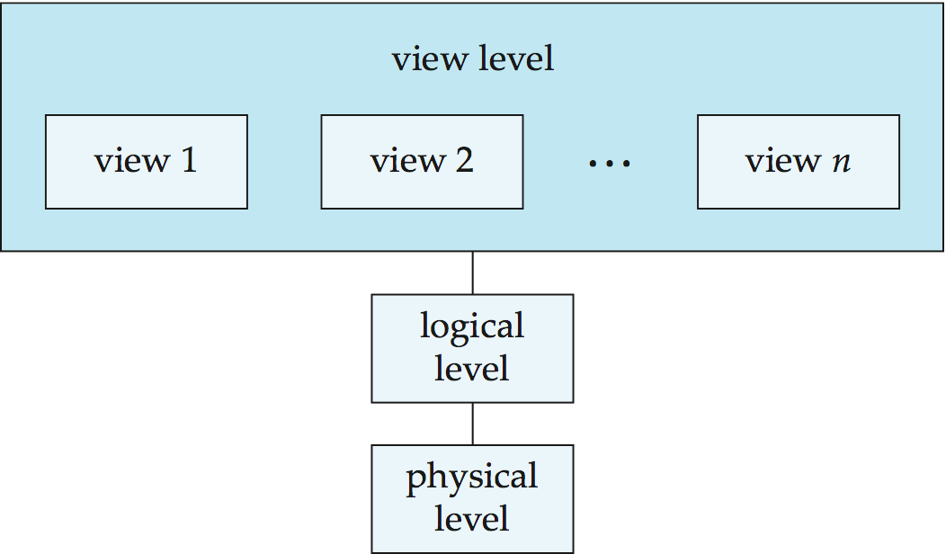
View of Data

Slide 7
Database Architecture

Slide 8
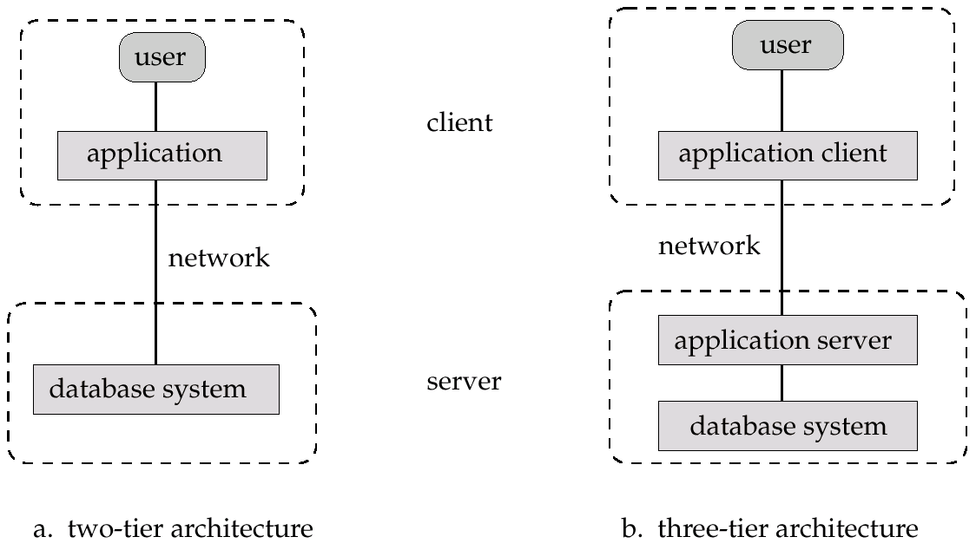
Two-Tier and Three-Tier Arcitecture

Slide 9
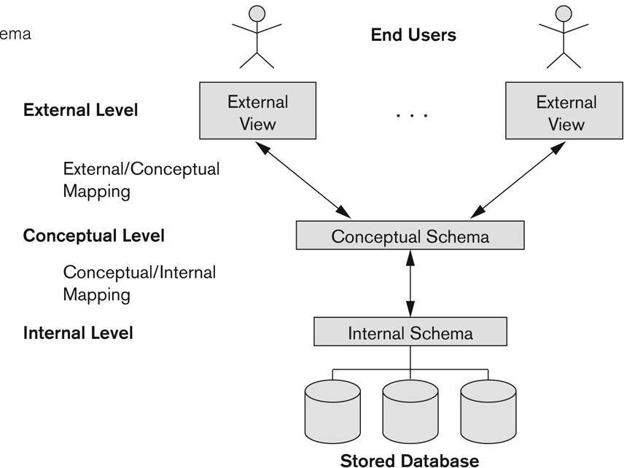
Three-Tier Architecture

Slide 10
External or View level: It is the users’ view of the database. This level describes that part of the database that is relevant to each user. – For example, one user may view dates in the form (day,month, year), while another may view dates as (year,month, day).
Conceptual or logical level: It is the community view of the database. This level describes what data is stored in the database and the relationships among the data. It represents: – All entities, their attributes, and their relationships; – The constraints on the data; – Security and integrity information.
Internal or storage level: It is the physical representation of the database on the computer. This level describes how the data is stored in the database.

Slide 11
Data Independence-Achievement of Layered Architecture of DBMS
Two kinds of data independence:
– Logical data independence
– Physical data independence

Slide 12
Data Independence
Logical Data Independence: The capacity to change the conceptual schema without having to change the external schemas and their application programs.
Physical Data Independence: The capacity to change the internal schema without having to change the conceptual schema.

Slide 13
Data Independence
The processes of transforming requests and results between the levels are called mappings.
When a schema at a lower level is changed, only the mappings between this schema and higher level schemas need to be changed in a DBMS that fully supports data independence. The higher schemas themselves are unchanged. Hence, the application programs need not be changed since they refer to the external schemas.

Slide 14
Data Model
A database model defines the logical design of data. The model also describes the relationships between different parts of the data.
Various types of data models are:
Object oriented model
Hierarchical data model
Relational data model
Network model

Slide 15
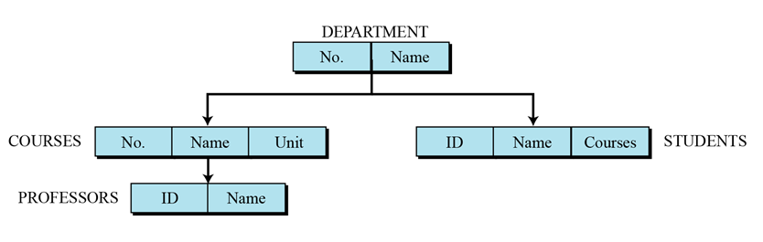
Data Models
Hierarchical data model: This is called a parent-child relationship. In this model each entity has only one parent but several children. At the top of the hierarchy there is only one entity which is called Root.

Slide 16
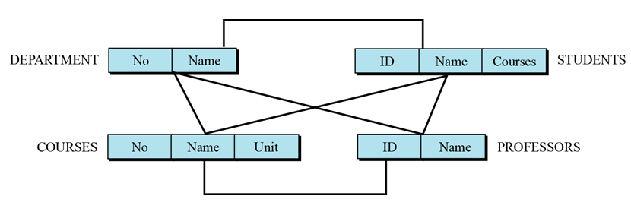
Data Models
Network model: In a network DBMS every data item can be related to many others ones. The database structure is like a graph. This is similar to the hierarchical model and also provides a tree-like structure. However, a child is allowed to have more than one parent.

Slide 17
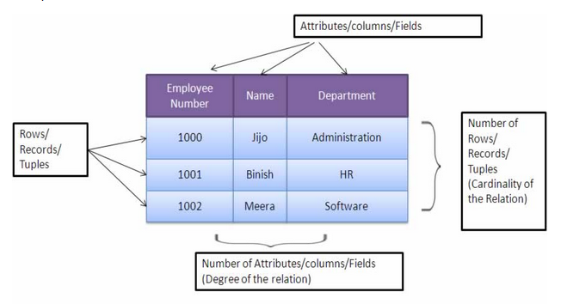
Data Models
Relational data model: In relational data model, data exists in two dimensional tables known as relations. A relation (table) consists of unique attributes (columns) and tuples (rows).

Slide 18
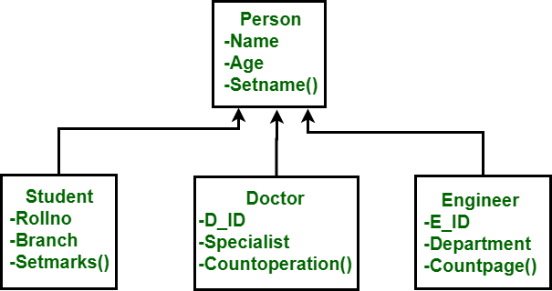
Data Models
Object oriented model: In this model data is stored in form of objects.

Slide 19
E-R Model
E-R Model was introduced by Peter Chenn in 1976.
It defines the conceptual (logical) view of a database.
It work around real-world entities and relationship among them.
A database schema in E-R Model can be represented pictorially by E-R diagram
An E-R diagram maps well into a relational schema.

Slide 20
E-R Model
An E-R Model maps well to the relational model i.e. the constructs used in the ER Model can be easily transformed into relational tables.
An ER Model can be used by the database designer to communicate the database design to the user
An ER Model can be used as a design plan by the database developer to implement a data model in specific DBMS software.

Slide 21
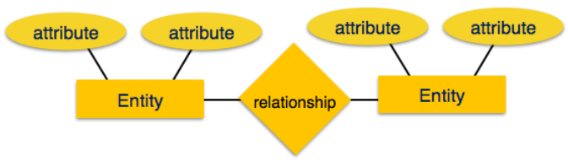
E-R Model
ER Model is based on:
Entities and their attributes
Relationships among entities

Slide 22
E-R Model components
Entity: An entity in ER Model is real world entity (Independent Existence), which has some properties called attributes. Every attribute is defined by its set of values, called domain. For example, in a school database, a student is considered as an entity. Student has various attributes like name, age and class etc.
An entity set is a collection of similar types of entities. For example, Students set may contain all the student of a school.

Slide 23
Attributes
Attributes describe the properties of the entity of which they are associated.
A particular instance of an attribute is a value. For example, "Ram" is one value of the attribute Name.
We can classify attributes as following:
¨ Simple
¨ Composite
¨ Single-valued
¨ Multi-valued
¨ Derived

Slide 24
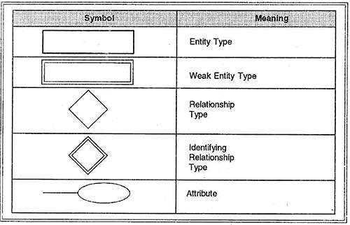
E-R Model: Symbols and notations

Slide 25
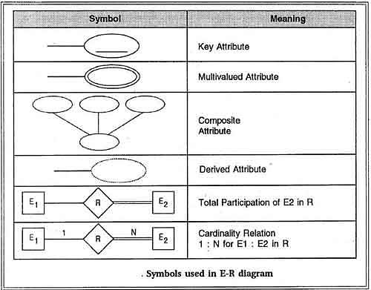
E-R Model: Symbols and notations

Slide 26
E-R Model
Relationship: The association among entities is called relationship. For example, employee entity has relation works_at with department.
Relationships are mapped with entities in various ways. Mapping cardinalities define the number of association between two entities.
Descriptive Attributes

Slide 27
Degree of Relationship
.The number of different entity sets participating in a relationship set is called as degree of a relationship set.
Unary(Degree=1)
Binary(Degree=2)
Ternary (Degree=3)
N-ary (Degree=n)

Slide 28
Constraints
Various types of constraints are:
Mapping cardinalities
Participation constraints
Keys

Slide 29
Mapping Cardinalities
Mapping cardinality defines the number of entity of any entity set participate in a relationship set. Mapping cardinalities:
one to one
one to many
many to one
many to many

Slide 30
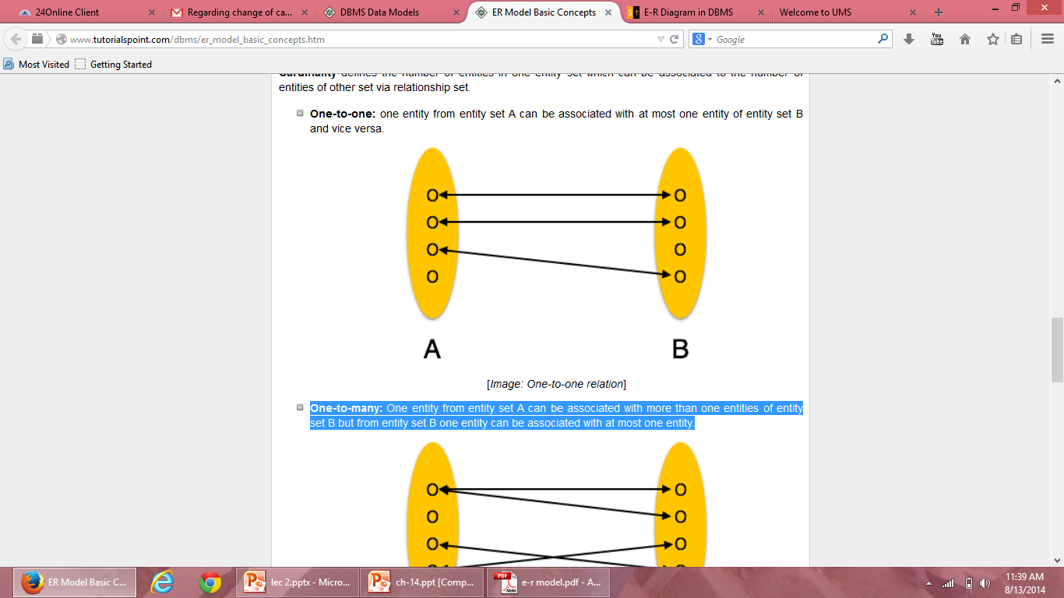
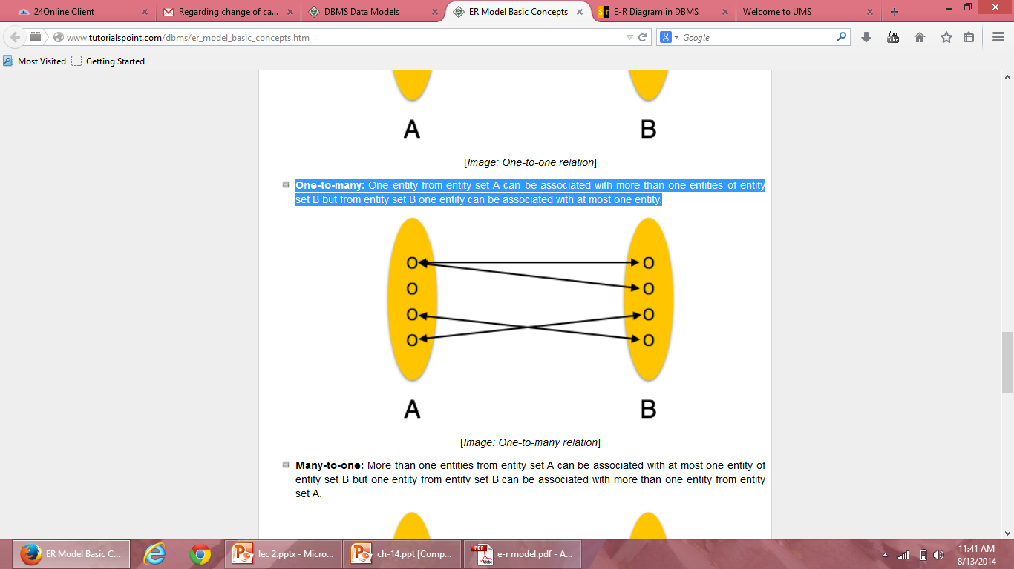
One-to-one: one entity from entity set A can be associated with at most one entity of entity set B and vice versa.
One-to-many: One entity from entity set A can be associated more than one entities of entity set B but from entity set B one entity can be associated with at most one entity.

Slide 31
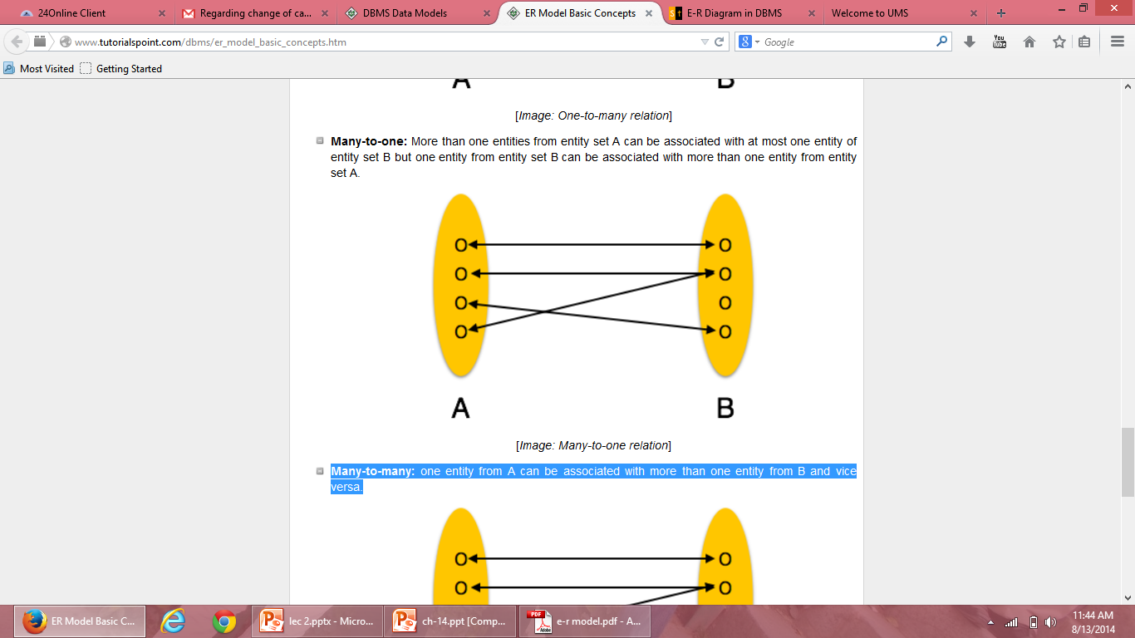
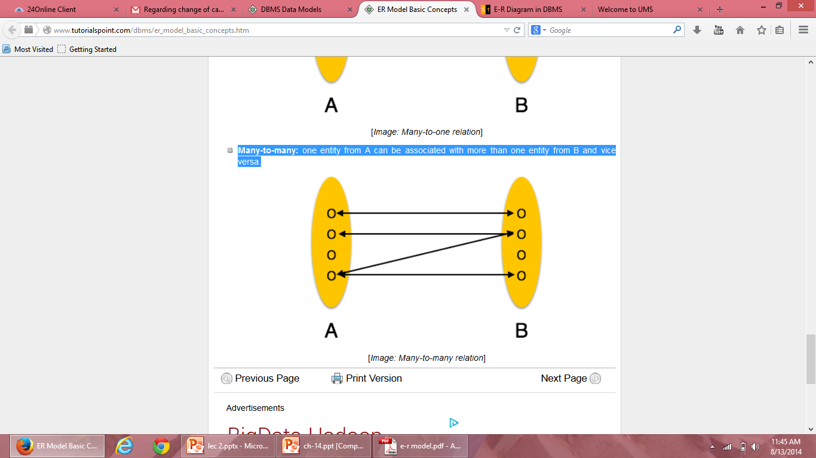
Many-to-one: More than one entities from entity set A can be associated with at most one entity of entity set B but one entity from entity set B can be associated with more than one entity from entity set A.
Many-to-many: one entity from A can be associated with more than one entity from B and vice versa.

Slide 32
Participation Constraints
The participation of an entity set E in a relationship set R is said to be total if every entity in E participates in at least one relationship in R.
If only some entities in E participate in relationships in R, the participation is said to be partial.

Slide 33
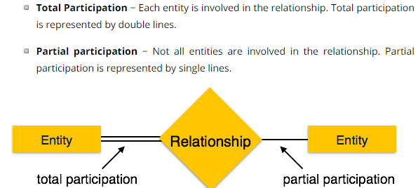
Total and Partial Participation

Slide 34
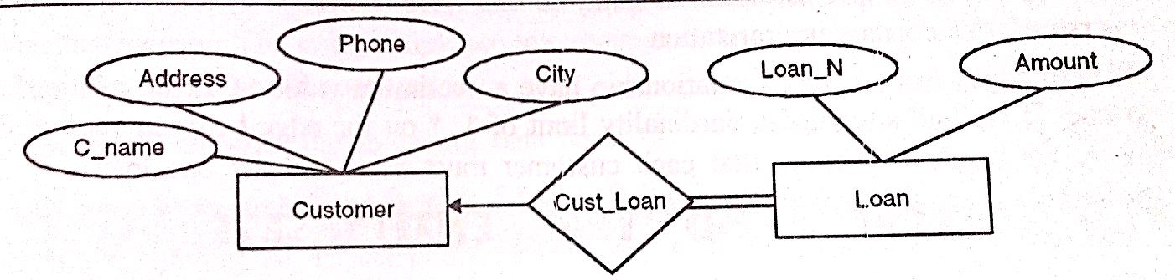
Example
borrower
Total participation of Loan entity

Slide 35
Total and Partial Participation
Relationships between entities can be optional or compulsory.
In our example, we could decide that a person is considered to be a customer only if they have bought a product.
On the other hand, we could say that a customer is a person whom we know about and whom we hope might buy something—that is, we can have people listed as customers in our database who never buy a product

Slide 36
Keys
The key is defined as the column or attribute of the database table.
They are used to establish and identify relation between tables.
They also ensure that each record within a table can be uniquely identified by combination of one or more fields within a table.

Slide 37
Types of Keys
Superkey: An attribute (or combination of attributes) that uniquely identifies each row in a table. It is a super set of candidate key.
Candidate key : An attribute (or set of attributes) that uniquely identifies a row. Let K be a set of attributes of relation R. Then K is a candidate key for R if it possess the following properties:
Uniqueness – No legal value of R ever contains two distinct tuples with the same value of K
Irreducibility- No proper subset of K has the uniqueness property

Slide 38
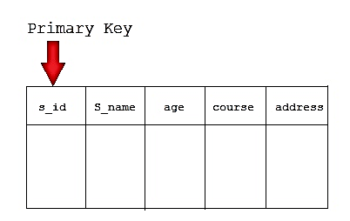
Types of Keys
3. Primary key : is the candidate key which is selected as the principal unique identifier. It is a key that uniquely identify each record in the table. Cannot contain null entries.

Slide 39
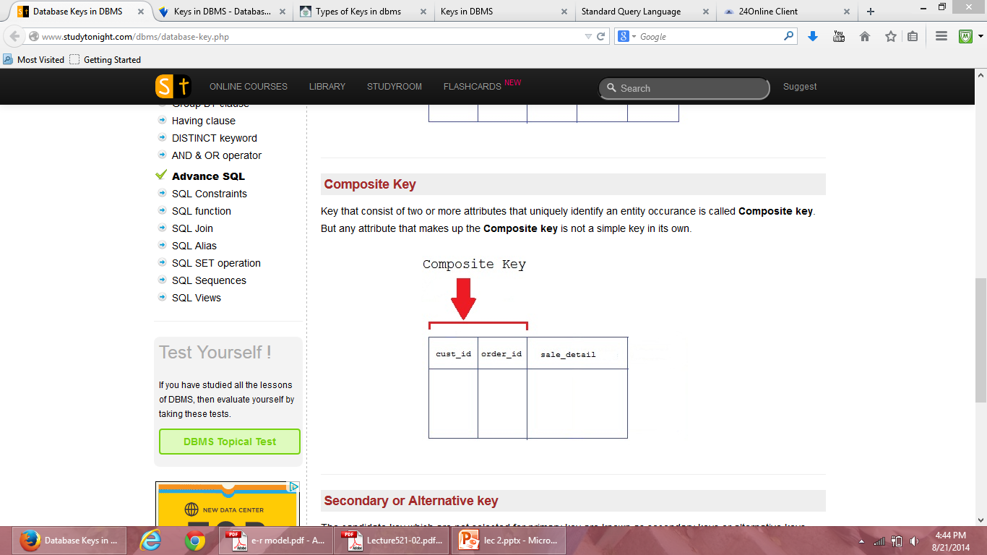
Types of Keys
4. Composite Key: Key that consist of two or more attributes that uniquely identifies an entity occurrence is called composite key.
Reg_no
Crs_id
subjects

Slide 40
Types of Keys
5. Foreign Key: A foreign key is generally a primary key from one table that appears as a field in another where the first table has a relationship to the second.
In other words, if we had a table A with a primary key X that linked to a table B where X was a field in B, then X would be a foreign key in B.

Slide 41
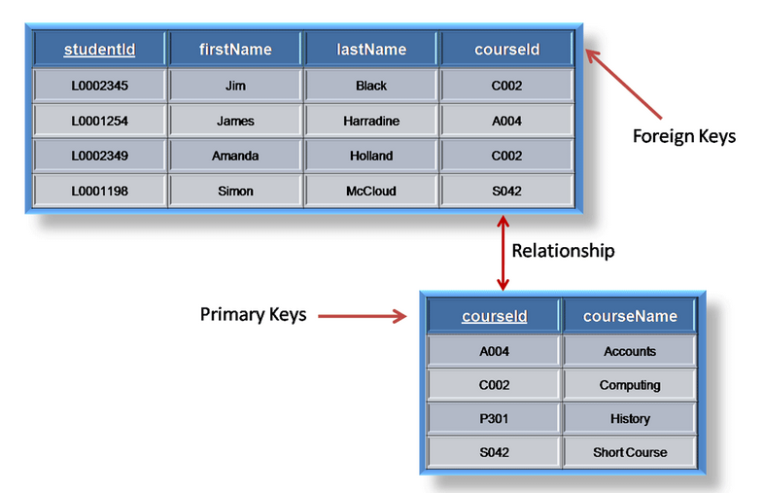
Example

Slide 42
Strong and Weak entity sets
The entity set which does not have sufficient attributes to form a primary key is called a Weak entity set.
The entity set which has the primary key is called as Strong entity set.
A member of a strong entity set is called dominant entity and member of a weak entity set is called subordinate entity.
Weak entity does not have a primary key but we need a mean to distinguish among other entities. The discriminator of a weak entity set is a set of attributes that allows this distinction to be made. Ex: payment_number.

Slide 43
Strong entity sets
The strong entity always have a primary key.
Its existence is not dependent on any other entity i.e. it is independent of other entity.
A set of strong entities is known as strong entity set.
Strong entity is represented by a single rectangle.

Slide 44
Weak entity sets
The weak entity does not have a sufficient attribute to form a primary key.
It depends on the strong entity to ensure its existence.
A set of weak entities is known as weak entity set.
Weak entity is represented by double rectangle.

Slide 45
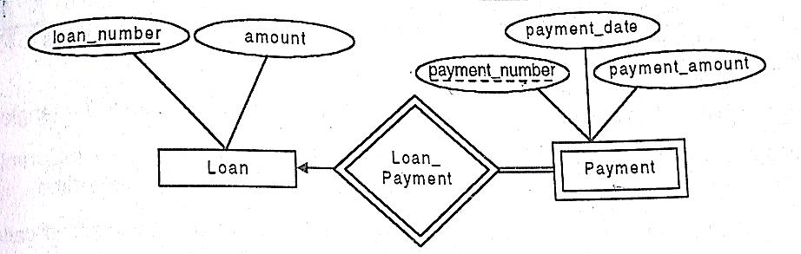
Example

Slide 46
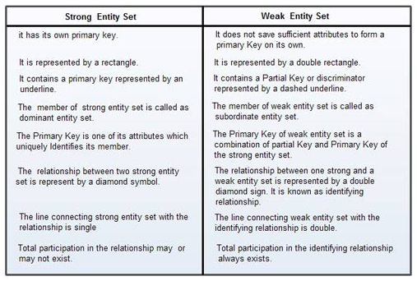
Weak and Strong Entity

Slide 47
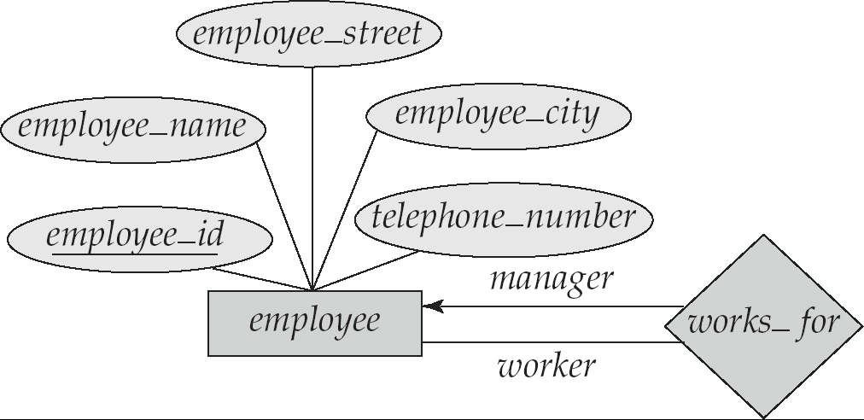
Roles
Entity sets of a relationship need not be distinct
The labels “manager” and “worker” are called roles; they specify how employee entities interact via the works_for relationship set.
Roles are indicated in E-R diagrams by labeling the lines that connect diamonds to rectangles.
Role labels are optional, and are used to clarify semantics of the relationship

Slide 48
Steps in designing E-R Diagram
There are following steps:
Identify the entities from the requirement sheets
Find relationships among those entities
Identify the key attributes for every entity
Identify other relevant attributes
Draw complete E-R diagram with all attributes including Primary key
Review your results with your Business users

Slide 49
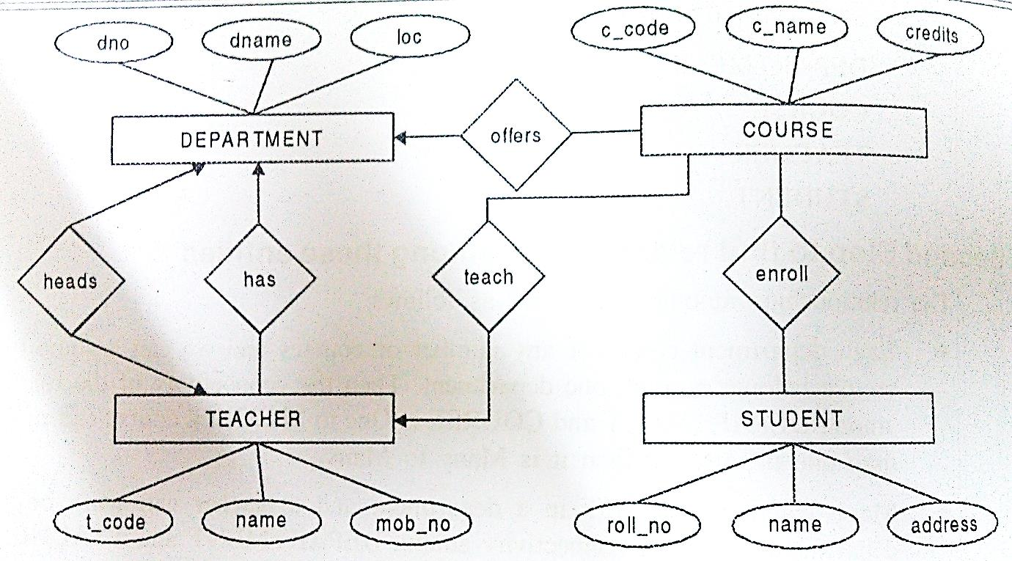
Example: University Management System

Slide 50
Example of ER Diagram
In case of college, a college contain many departments
Each dept. can offer any number of courses
Many instructor can work in a dept.
An instructor can work only in one dept.
For each dept. there is head
An instructor can be head of only one dept.
Each instructor can take any no. of courses
A course can be taken by only one instructor
A student can enroll for any no. of courses
Each course can have any no. of students

Slide 51
Example of ER Diagram
Step 1 : Identify the Entities
What are the entities here?
From the statements given, the entities are
Department
Course
instructor
Student

Slide 52
Example of ER Diagram
Step 2 : Identify the relationships
One department offers many courses. But one particular course can be offered by only one department. hence the cardinality between department and course is One to Many (1:N)
One department has multiple instructor . But instructor belongs to only one department. Hence the cardinality between department and instructor is One to Many (1:N)
One department has only one head and one head can be the head of only one department. Hence the cardinality is one to one. (1:1)
One course can be enrolled by many students and one student can enroll for many courses. Hence the cardinality between course and student is Many to Many (M:N)
One course is taught by only one instructor. But one instructor teaches many courses. Hence the cardinality between course and instructor is Many to One (N :1)

Slide 53
Example of ER Diagram
Step 3: Identify the key attributes
"Departmen_Name" can identify a department uniquely. Hence Department_Name is the key attribute for the Entity "Department".
Course_ID is the key attribute for "Course" Entity.
Student_ID is the key attribute for "Student" Entity.
instructor _ID is the key attribute for " instructor " Entity.

Slide 54
Example of ER Diagram
Step 4: Identify other relevant attributes
For the department entity, other attributes are location
For course entity, other attributes are course_name,duration
For instructor entity, other attributes are first_name, last_name, phone
For student entity, first_name, last_name, phone

Slide 55
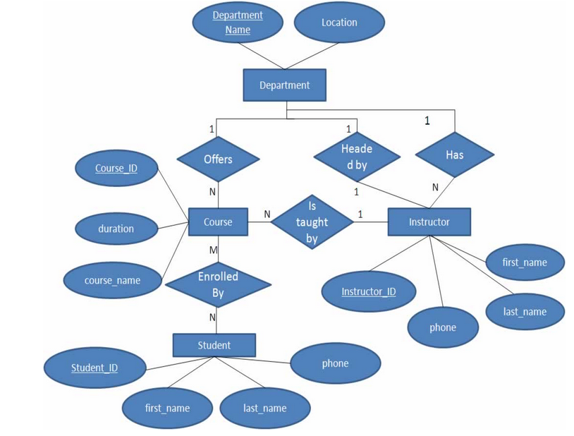
Example of ER Diagram

Slide 56
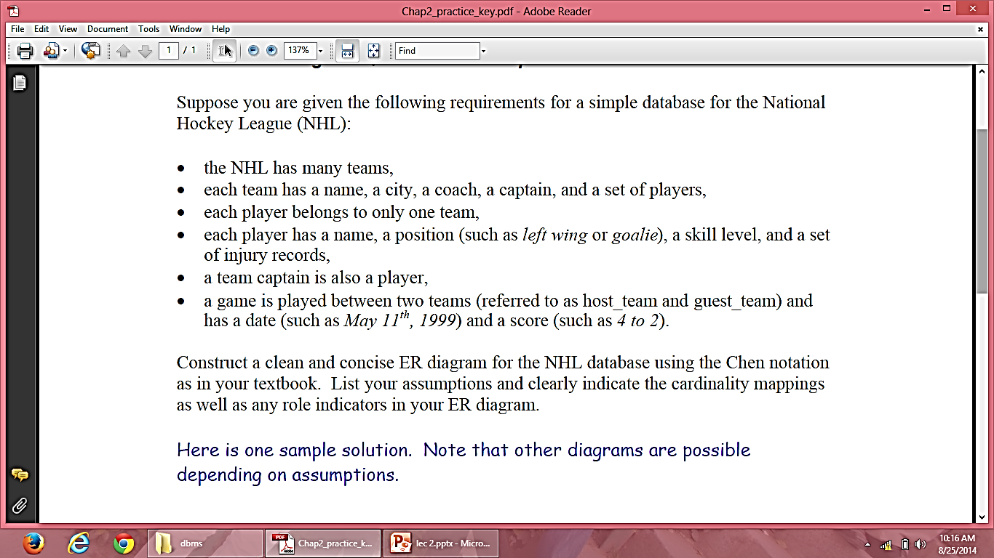
Example

Slide 57
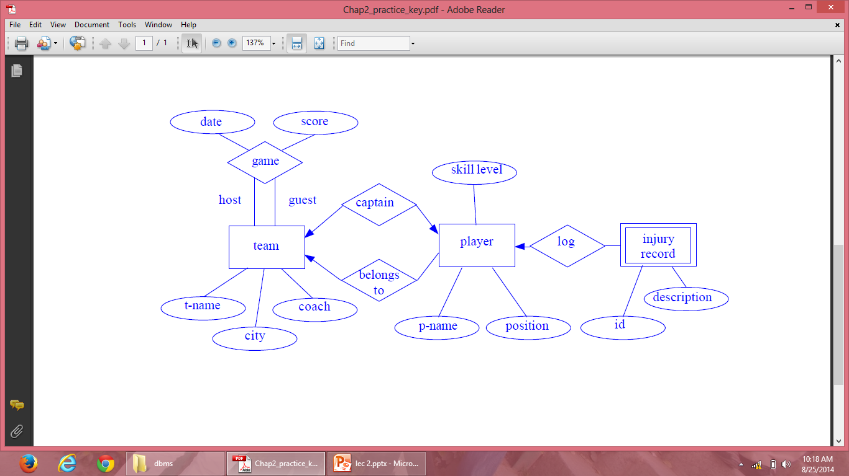
E-R Diagram

Slide 58
Generalization
Generalization is a process in which a new entity is formed using the common attributes of two or more entities.
Generalization simplifies the ER diagram by clubbing the common attributes together.
Below are some characteristics of generalization:
Generalization follows the bottom-up approach.
It generalizes or simplifies the entities.
Higher-level entities can be made with combining lower-level entities.
Generalization is used to emphasize the similarities among lower-level entity set and to hide differences in the schema

Slide 59
Entities Before Generalization
Below will be the entities before generalization:
Car Entity: Car entity can have attributes like car_ID, DateManufactured, Cost, Model, Manufacturer which will be generalized further.

Slide 60
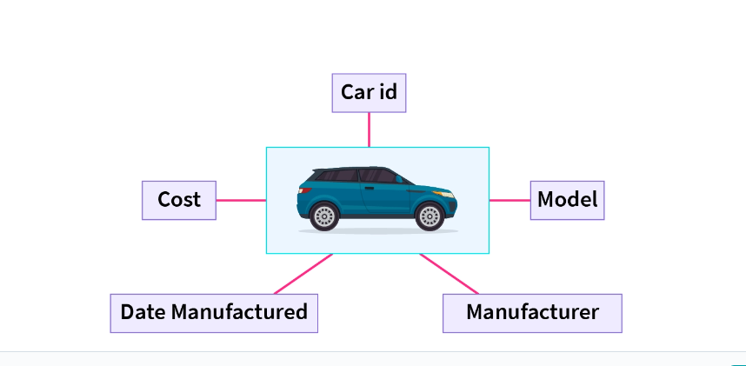

Slide 61
Bike Entity: Bike entity can have attributes like bike_ID, DateManufactured, Cost, Model, Manufacturer which will be generalized further.

Slide 62
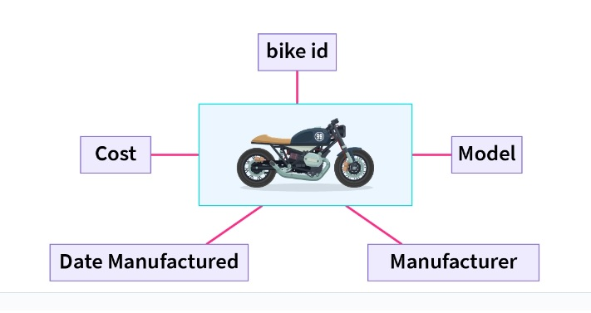

Slide 63
ER Diagram after Generalization
We can see that for cars and bikes some attributes like DateManufactured, Cost, Model, Manufacturer are the same so we can generalize them into an entity called Vehicle.
The vehicle entity will be having these common attributes and the bike and car entity will be related to them using "Is A" relationship table, So ER diagram can be generalized by:

Slide 64
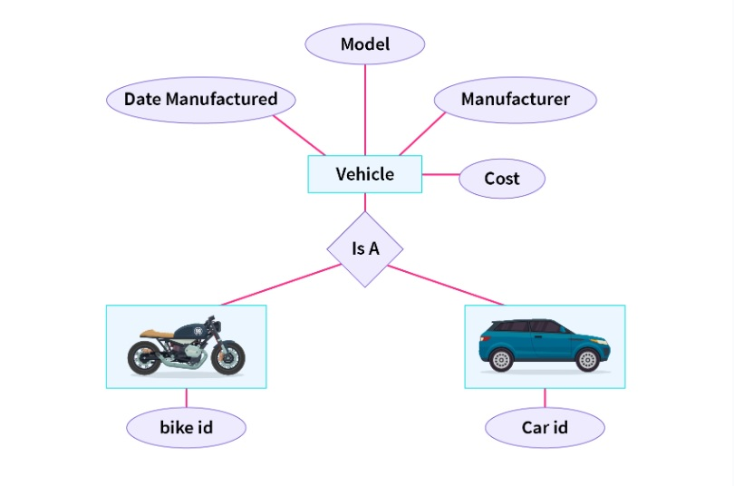

Slide 65
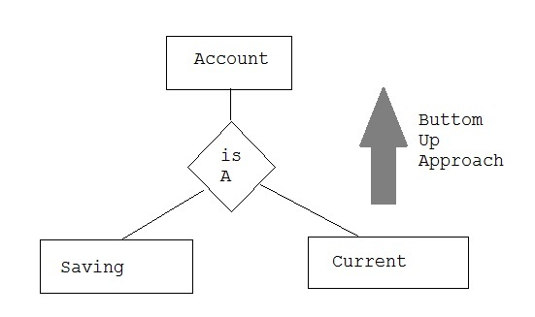
Example

Slide 66
Specialization
It is opposite of Generalization.
In specialization, an entity is broken down into sub-entities based on their characteristics.
It is Top-Down approach, where higher level entities is specialized into two or more lower level entities.
Specialization is used to identify the subset of an entity set that shares some distinguishing characteristics.
Specialization can be repeatedly applied to refine the design of schema.
It is depicted by triangle component “is a”.

Slide 67
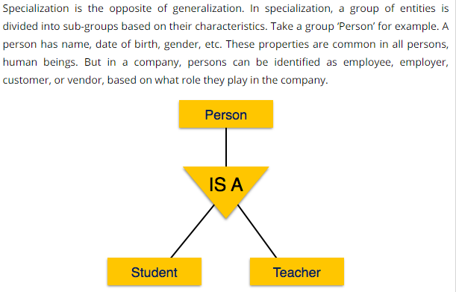
Specialization

Slide 68
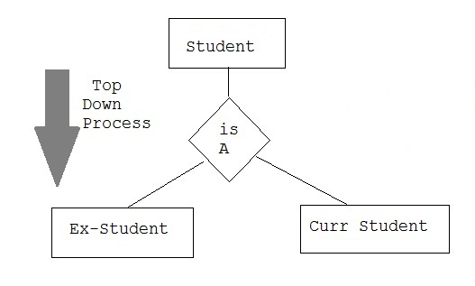
Specialization

Slide 69
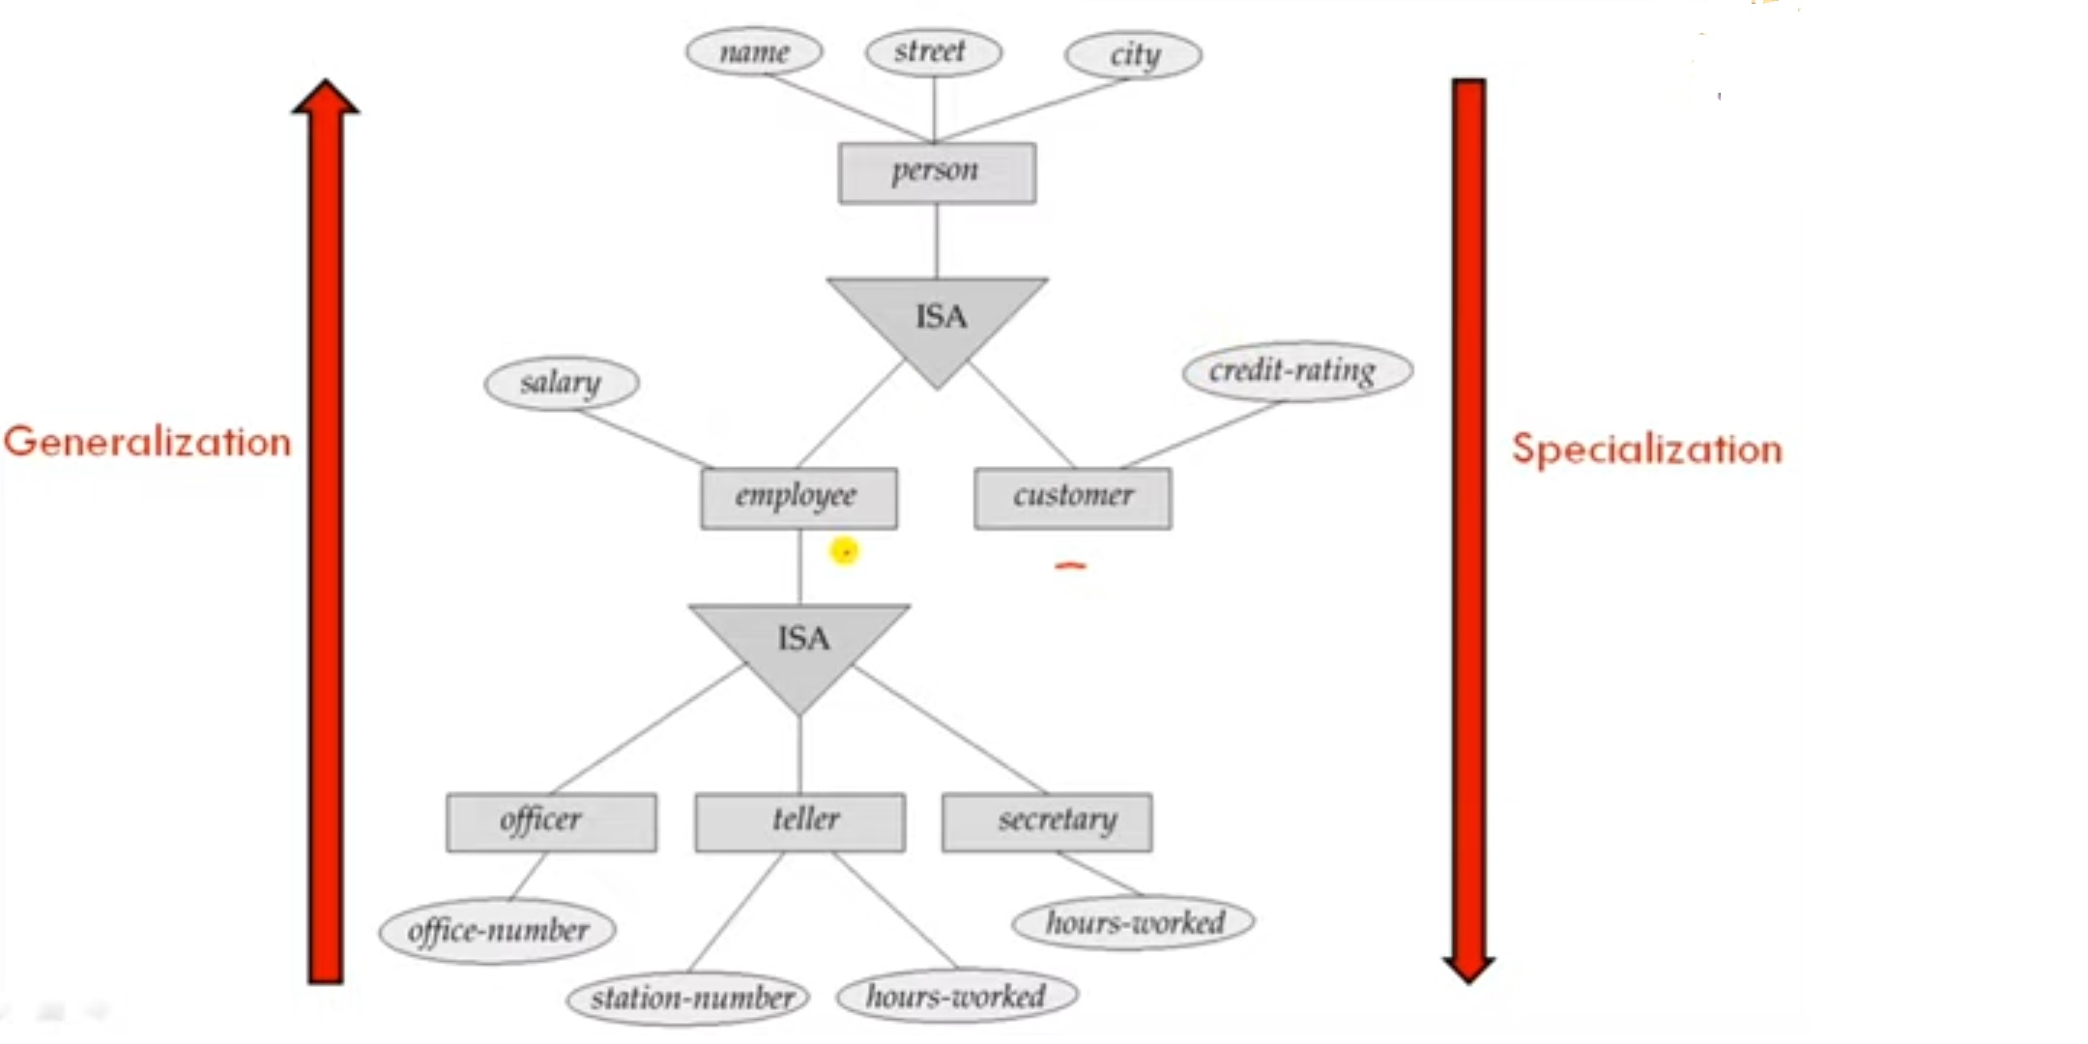

Slide 70
Aggregation
Aggregation is a process when relation between two entity is treated as a single entity.
Aggregation is used when we need to express a relationship among relationships.
Aggregation is an abstraction through which relationships are treated as higher-level entities.
Aggregation is a process when a relationship between two entities is considered as a single entity and again this single entity has a relationship with another entity.

Slide 71
Its main motive is treating these relationships as a single one.
This process is mainly performed when the entities don’t look good and need to be aggregated to get desired results.

Slide 72
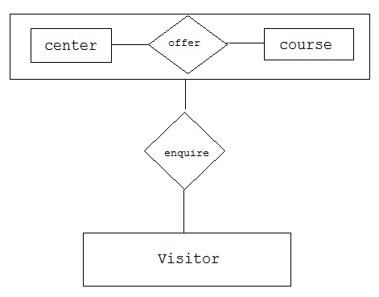
Aggregation

Slide 73
Aggregation
The E-R model cannot express relationships among relationships.
When would we need such a thing?
Consider a DB with information about employees who work on a particular project and use a number of machines doing that work.

Slide 74
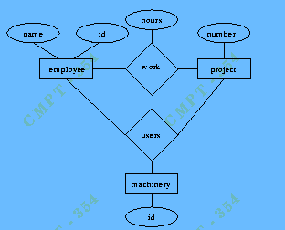
Aggregation

Slide 75
Aggregation
Relationship sets work and uses could be combined into a single set. However, they shouldn't be, as this would obscure the logical structure of this scheme.
The solution is to use aggregation.
An abstraction through which relationships are treated as higher-level entities.
For our example, we treat the relationship set work and the entity sets employee and project as a higher-level entity set called work.

Slide 76
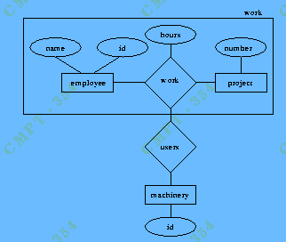
Aggregation

